Slide 1
CE1107/CZ1107: DATA STRUCTURES AND ALGORITHMS
Queues
Notes:
This lecture is on Queue data structure. Queues are not much different from Stacks.

Slide 2
Today
Motivating application
Queue data structure
Queue implementation using linked lists
Queue functions
enqueue()
dequeue()
peek()
isEmptyQueue()
Worked examples: Applications
Notes:
We will discuss about queue data structures, its core functions and their implementation using linked lists. All are very similar to what we have learned in Stacks but for adding and removing nodes we have different names as enqueue and dequeue.

Slide 3
Learning objectives
After this lesson, you should be able to:
Explain how a queue data structure operates
Implement a queue using a linked list
Choose a queue data structure when given an appropriate problem to solve
You should also be able to
Implement a queue using an array (but we won’t cover or test this)
Notes:
At the end of this lecture, you should be able to:
Explain how a queue works
Why it is different from stacks
How the core functions implement in C using linked lists

Slide 4
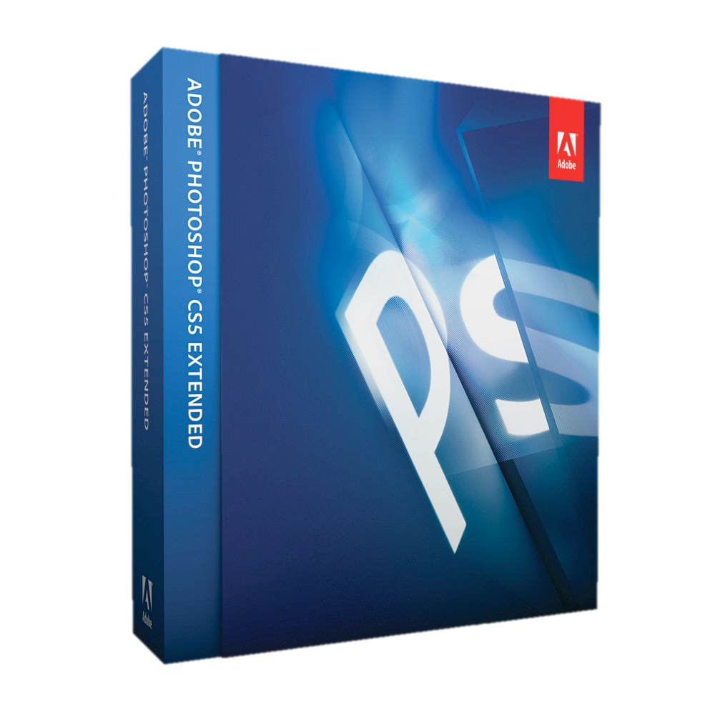



Motivating ApplicatioN #1
Write a printer driver application:
Print jobs may be sent to the printer driver at any time
A print job must be stored until it can be sent to the printer
Print jobs are sent in first-come, first-served order to the printer
Print jobs take a long time to complete
When a print job completes, the next waiting print job should be sent to the printer
Notes:
Consider a scenario where you have a printer which is shared by multiple applications on your computer. So, all the applications in your computer are linked with this printer and therefore, you can print only one at a time.
The printing order is a first come first serve order. For example, at first you send a Word document, then send an Excel document and finally send a Powerpoint document. Then the at first, the printer prints the Word document, then the Excel document and finally the Powerpoint document. This is what we call a first in first out data structure. This is different from a Stack because a stack has a first in last out data structure.
In queues, if the first task takes a while to complete, the following tasks also will be held in the queue, waiting for their turn.

Slide 5
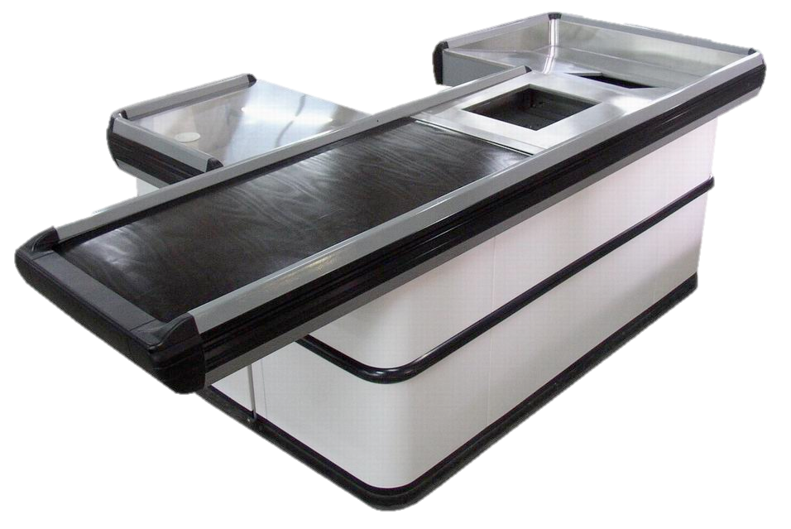

Motivating ApplicatioN #2
Supermarket checkout counter assignment
1 checkout counter OR N checkout counters
Single queue of customers
First-come, first-served bases
Join the back of the queue and wait for your turn
Notes:
In the previous example, the tasks are coming from different sources and running into one printer. Now, imagine an a queue in a supermarket. People are being queued to different checkout counters.
The first person in the queue will be served first. The queueing allows to make sure that serving is done fairly.

Slide 6

Motivating ApplicatioN #3
Sequence of commands for a unit in a game
Commands may be added to the sequence at any time
Must be carried out in this order
Move there
Attack
Move there
Etc..
Self-destruct
Notes:
If you are playing a game, you have a sequence of commands such as move a unit from position X to position Y, attack a unit, build something, etc. You obviously don’t want the sequence of commands to be overridden once you add a new command to the list. They should be executed in that order.
This is where you need a queue. The first item in should be the first command to process.

Slide 7
Today
Motivating application
Queue data structure
Queue implementation using linked lists
Queue functions
enqueue()
dequeue()
peek()
isEmptyQueue()
Worked examples: Applications
Notes:
Let’s discuss about Queue data structure.

Slide 8
PREVIOUSLY
Arrays
Random access data structure
Linked lists
Sequential access data structure
Limited-access sequential data structures
Stack
Last In, First Out (LIFO)
Today, another limited-access sequential data structure
Notes:
In previous lectures, we learned that arrays are random access data structures. Once you have the index position, you can access any array element. Linked list is a sequential access data structure. We need to traverse from the first node.

Slide 9

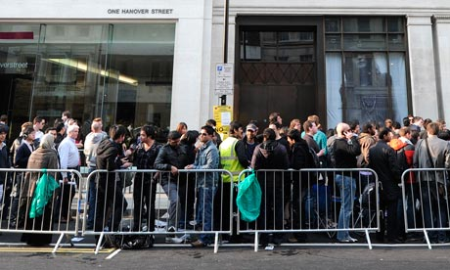

QUEUE DATA STRUCTURE
A Queue is a data structure that operates like a real-world queue
Queue to use an ATM or buy food, for example
Elements can only be added at the back
Elements can only be removed from the front
Key: First-In, First-Out (FIFO) principle
Or, Last-In, Last-Out (LILO)
As with stacks, often built on top of some other data structure
Arrays, Linked lists, etc.
We’ll focus on a linked-list based implementation again
Notes:
Limited access sequential data structures are like taking linked list and constraining it some more such allowing only access the front. This is stack data structures which is last in first out or first in last out. In this lecture we discuss about queue data structures which is first in first out or last in last out.
We add elements at the back of the queue and remove the elements from the front. This is what gives us the first in first out order.
We can build the queue structure just like we built the stacks. We will use the linked lists because we do not want to focus on the management of the nodes.

Slide 10
QUEUE DATA STRUCTURE
Core operations
Enqueue: Add an item to the back of the queue
Dequeue: Remove an item from the front of the queue
Common helpful operations
Peek: Inspect the item at the front of the queue without removing it
IsEmptyStack: Check if the queue has no more items remaining
Corresponding funtions
enqueue()
dequeue()
peek()
isEmptyQueue()
We’ll build a queue assuming that it only deals with integers
But as with linked lists and stacks, can deal with any contents depending on your code
Notes:
The core operations are enqueue and dequeue. Enqueue adds items to the back of the queue and dequeue allows you to remove items from the front. The peek function allows to look at the first item before we remove it and isEmptyQueue function determines if there is anything left inside the queue.
We will build these four functions. Only the enqueue and dequeue functions are going to be completely different.

Slide 11
Today
Motivating application
Queue data structure
Queue implementation using linked lists
Queue functions
enqueue()
dequeue()
peek()
isEmptyQueue()
Worked examples: Applications
Notes:
As in the stack, we define queue with a linked list struct.

Slide 12
QUEUE IMPLEMENTATION USING LINKED LISTS
Recall that we defined a LinkedList structure
Next, we define a Stack structure
Now, define a Queue structure
We’ll build our queue on top of a linked list
typedef struct _queue{
LinkedList ll;
} Queue;
Notes:
So, do we want the front of the queue to correspond to the first node of the linked list? Or, do we need the back of the queue to correspond to the first node of the linked list? When we asked these questions when we learned stack, the answer was that it doesn’t matter.

Slide 13
QUEUE IMPLEMENTATION USING LINKED LISTS
Queue structure
typedef struct _queue{
LinkedList ll;
} Stack;
Again, wrap up a linked list and use it for the actual data storage
Notice that the LinkedList already takes care of little things like keeping track of # of nodes, etc.
There is one modification we need for a queue… KIV
Notice this is a LinkedList, not a LinkedList *
LinkedList ll
Queue q
ListNode *head
int size
Notes:
Now, is it same with queue data structure? Actually, it shouldn’t matter if the linked list has a tail pointer. So, the implementation of queue using linked list is different from stacks because here we use the tail pointer to access the both ends of the structure. With stack, we only access items at one position.
Therefore, with queue data structure, to have it properly implemented and running efficiently, I actually need to make sure that my linked list has a tail pointer inside.

Slide 14
Today
Motivating application
Queue data structure
Queue implementation using linked lists
Queue functions
enqueue()
dequeue()
peek()
isEmptyQueue()
Worked examples: Applications
Notes:
Let’s look at the enqueue and dequeue functions in detail. The enqueue function supposed to add items to the back of the linked list and the dequeuer functions supposed to remove items from the front of the linked list.

Slide 15
QUEUE FUNCTIONS: enqueue()
enqueue() function is the only way to add an element to the queue data structure
Only allowed to enqueue() at the end
Question:
Using a linked list as the underlying data storage, does the first linked list node represent the front or the back of the queue?
Figure out which option makes it easier to implement enqueue() and dequeue()
LinkedList ll
Queue q
ListNode *head
int size
Notes:
So if you think about which index positions you are going to be accessing, you will realize that you need to access either position zero and the last index, or if you flip it around, it's still going to be position zero and the last index position.

Slide 16
QUEUE FUNCTIONS: enqueue()
Hands-on: Write the enqueue() function
Define the function prototype
Implement the function
Very similar to what we did for stack: push()
Answer is a few slides down, so don’t look yet
Requirements
Make use of the LinkedList functions we’ve already defined
Insert at the back only (what index position?)
LinkedList ll
Queue q
ListNode *head
int size
Notes:
We will implement the enqueue function now.

Slide 17
QUEUE FUNCTIONS: enqueue()
Hands-on: Write the enqueue() function
Before looking at the code on the next slide, try writing the code for yourself
void enqueue(Queue *q, ){
}
LinkedList ll
Queue *q
ListNode *head
int size
Notes:
The enqueue function is going to accept a pointer to the queue. Also, we need to pass the value that we need to add to the queue.

Slide 18
QUEUE FUNCTIONS: enqueue()
First linked list node corresponds to the front of the queue
Last linked list node corresponds to the back of the queue
Enqueueing a new item → adding a new node to the end of the linked list
void enqueue(Queue *q, int item){
insertNode(&(q->ll), q->ll.size, item);
}
Notice that this could be a very inefficient operation if the queue is long
Need to use a tail pointer to make the operation efficient
Gives us direct access to the current last node of the linked list
Also note that the inefficient version still works
int insertNode(LinkedList *ll, int index, int value)
Notes:
Just like the stack push function, this is a simple insert node call. For enqueue, we are going to add items to the last position of the linked list. Therefore, the correct index position is ll.size because the index position of the last item in the linked list is size-1.
In order for this to be efficient, we need to give direct access to the last node of the linked list. So, we need a tail pointer. It will still work without a tail pointer, but then it will be very inefficient because every time we add an item, we have to start from the front and travers all the way down.

Slide 19
QUEUE FUNCTIONS: dequeue()
Dequeueing a value is a two-step process again
Get the value of the node at the front of the linked list
Remove that node from the linked list
int dequeue(Queue *q){
int item;
item = ((q->ll).head)->item;
removeNode(&ll, 0);
return item;
}
Need a temporary int variable to hold the stored value because we can’t get it after we remove the front node
LinkedList ll
Queue *q
ListNode *head
int size
int removeNode(LinkedList *ll, int index)
Notes:
Dequeue is a two-step process because we need to hold the value before deleting the node from the linked list. So, just as in stack data structure, we call remove node from the index position 0. The only difference of this with stack data structure is that enqueue is dealing with the last position rather than the 1st position as in the stack.

Slide 20
QUEUE FUNCTIONS: peek()
No change in logic from the stack version
Peek at the value at the front of the queue
Get the value of the node at the front of the linked list
Without removing the node
int peek(Queue *q){
return ((q->ll).head)->item;
}
Notes:
So the peek function is also the same thing. Only difference is that I’m passing in a queue instead of a stack.

Slide 21
QUEUE FUNCTIONS: isEmptyQueue()
Again, exactly the same logic as isEmptyStack()
Check to see if # of nodes == 0
Make use of the built-in size variable in the LinkedList struct
int isEmptyQueue(Queue *q){
if ((q->ll).size == 0) return 1;
return 0;
}
Notes:
isEmptyQueue functions is also doing the same thing, Here, we will use the built in size variable and check the value of the size variable.

Slide 22
Today
Motivating application
Queue data structure
Queue implementation using linked lists
Queue functions
enqueue()
dequeue()
peek()
isEmptyQueue()
Worked examples: Applications
Notes:
Let’s see simple example that uses enqueue(), dequeue(), and isEmptyQueue() functions.

Slide 23
SIMPLE TEST APPLICATION
Simple application
Enqueue some integers
Dequeue and print
1
2
3
4
5
6
7
8
9
10
11
12
13
14
15
int main(){
Queue q;
q.ll.head = NULL;
q.ll.tail = NULL;
enqueue(&q, 1);
enqueue(&q, 2);
enqueue(&q, 3);
enqueue(&q, 4);
enqueue(&q, 5);
enqueue(&q, 6);
while (!isEmptyQueue(&q))
printf("%d ", dequeue(&q));
}
Notes:
To make this work properly, we need to set the head and tail pointers. To add an item, we just need to call the enqueue function and pass in the value. So, we add the values, 1, 2, 3, 4, 5 and 6. And then we print whatever is returned from the dequeue function. Because it is first in first out, when we print, it will the same order as they inserted which is 1, 2, 3, 4, 5 and 6.

Slide 24
SIMPLE TEST APPLICATION
1
2
3
4
5
6
7
8
9
10
11
12
13
14
15
int main(){
Queue q;
q.ll.head = NULL;
q.ll.tail = NULL;
enqueue(&q, 1);
enqueue(&q, 2);
enqueue(&q, 3);
enqueue(&q, 4);
enqueue(&q, 5);
enqueue(&q, 6);
while (!isEmptyQueue(&q))
printf("%d ", dequeue(&q));
}
void enqueue(Queue *q, int item);
int dequeue(Queue *q);
int peek(Queue *q);
int isEmptyQueue(Queue *q);

Slide 25
Motivating ApplicatioN #1
Application sends print job to driver by calling addPrintJob()
This will enqueue() the print job
When printer finishes the current print job, it calls getNextPrintJob()
This will dequeue() from the queue
Neither the application nor the printer has to care about other waiting print jobs, etc.
All print jobs will be processed in FIFO order
Notes:
If we go back to this motivating application, because queue structure takes care of keeping everything in the right order, the printer does not have to care about the order. The next print job will call the dequeue and gets the next item to process.

Slide 26
Motivating ApplicatioN #2
To checkout, join the queue at the back
When any of the checkout counters becomes available, it calls getNextCustomer()
First-come, first-served order of processing guaranteed
Checkout counters don’t have to care about all other waiting customers
Notes:
And likewise over here, with a single queue of people and multiple checkout counters, the people just stay in their position in the queue, they are not allowed to move around, they are not allowed to say, person at the back come forward. And all of these individual checkout lines don't care about who is third forth fifth sixth seventh, they only care about who is next, who is at the front of the queue.

Slide 27
Today
Motivating application
Queue data structure
Queue implementation using linked lists
Queue functions
enqueue()
dequeue()
peek()
isEmptyQueue()
Worked examples: Applications
Notes:
Today we learned about queues and its functions.

Slide 28
You should figure out which one is pointer, which one is not
When should I use “->” or ”.” ?
pointer->
Non-pointer.
Queue structure
typedef struct _queue {
LinkedList ll;
}Queue;
Queue q; Queue Structure
q.ll LinkedList
q.ll.head
(q.ll.head)->num integer
Queue *q;
q->ll LinkedList
q->ll.head
(q->ll.head)->num integer
Is a pointer
ListNode pointer
ListNode pointer
LinkedList ll
Queue q
*head
20
30
40
Queue* q
size

Slide 29
Linked List, Stack and Queue Functions
void printList(LinkedList *ll);
ListNode * findNode(LinkedList *ll, int index);
int insertNode(LinkedList *ll, int index, int value);
int removeNode(LinkedList *ll, int index);
void push(Stack *s, int item);
int pop(Stack *s);
int peek(Stack *s);
int isEmptyStack(Stack *s);
void enqueue(Queue *q, int item);
int dequeue(Queue *q);
int peek(Queue *q);
int isEmptyQueue(Queue *s);

Slide 30
STACK IMPLEMENTATION USING LINKED LISTS
Stack structure
typedef struct _stack{
LinkedList ll;
} Stack;
Basically wrap up a linked list and use it for the actual data storage
Just need to ensure we control where elements are added/removed
Notice that the LinkedList already takes care of little things like keeping track of number of nodes, etc.
Notice this is a LinkedList, not a LinkedList *
Stack s
LinkedList ll
ListNode *head
int size
Notes:
Now the previous diagram has changed. We have an outer box for stack that covers the linked list struct. We are trying to build the concept that is visualized in the left diagram.
A stack has the values that are come in and go out only at the top position of the stack. But if we look at the memory layout, at the end we will get a stack structure. Inside the stack struct we have the linked list struct and inside the linked list struct we have two items as the head pointer and the size variable.
This is the simplest form of linked list we can have which does not include doubly linked nodes, or tail pointers. We have the nodes outside the struct and connected to the struct via the head pointer. The nodes are defined as external blocks of memory. Therefore, now we have a stack struct which wraps up the linked list structure which warps up a head pointer and a size variable.
In this way we do not need to worry about rewriting the code. For an example, if we want to add an item to the stack we have to call the insert node function in the linked list.

Slide 31
QUEUE IMPLEMENTATION USING LINKED LISTS
Queue structure
typedef struct _queue{
LinkedList ll;
} Queue;
Again, wrap up a linked list and use it for the actual data storage
Notice that the LinkedList already takes care of little things like keeping track of # of nodes, etc.
Notice this is a LinkedList, not a LinkedList *
LinkedList ll
Queue q
ListNode *head
int size

Slide 32
initialising
Stack.c
1
2
3
4
5
6
7
8
9
10
11
#include "stdio.h"
#include <stdlib.h>
typedef struct stack{
LinkedList ll;
} Stack;
void push(Stack *s, int item);
int pop(Stack *s);
int peek(Stack *s);
int isEmptyStack(Stack *s);
Queue.c
1
2
3
4
5
6
7
8
9
10
#include "stdio.h"
#include <stdlib.h>
typedef struct _queue{
LinkedList ll;
} Queue;
void enqueue(Queue *q, int item);
int dequeue(Queue *q);
int isEmptyQueue(Queue *s);

Slide 33
stack functions
void push(Stack *s, int item){
insertNode(&(s->ll), 0, item);
}
int pop(Stack *s){
int item;
item = ((s->ll).head)->item;
removeNode(&(s->ll), 0);
return item;
}
int peek(Stack *s){
return ((s->ll).head)->item;
}
int isEmptyStack(Stack *s){
if ((s->ll).size == 0)
return 1;
return 0;
}
peek(s) = 3
push(s, 3)
pop(s)
push(s, 2)
push(s, 4)
push(s, 1)
4
3
2
1
Stack *s

Slide 34
Queue functions
void enqueue(Queue *q, int item){
insertNode(&(q->ll), q->ll.size, item);
}
int dequeue(Queue *q){
int item;
item = ((q->ll).head)->item;
removeNode(&(q->ll), 0);
return item;
}
int isEmptyQueue(Queue *q){
if ((q->ll).size == 0)
return 1;
return 0;
}
queue *q
1
2
3
4
dequeue(q)
enqueue(q, 2)
enqueue(q, 3)
enqueue(q, 4)
enqueue(q, 1)

Slide 35
Question 1
Write a c function reverseStack() that reverses a stack using a queue.
Note that the reverseStack() function only uses push() and pop() when adding or removing integers from the stack, and only uses enqueue() and dequeue() when adding or removing integers from the queue.
void reverseStack(Stack *s);
For example: if the stack is <5, 4, 3, 2, 1>, the resulting stack will be <1, 2, 3, 4, 5>

Slide 36
Question 1 - Template.c
Question 1: Reverse Stack using Queue
1
2
3
4
5
6
7
8
9
10
11
12
13
14
15
16
17
18
19
20
21
22
23
24
25
26
27
28
29
30
//////////////////////////////////////////////////////////////////////////////////
#include <stdio.h>
#include <stdlib.h>
#include <limits.h>
////////////////////////////////// linked list /////////////////////////////////
typedef struct _listnode{
int item;
struct _listnode *next;
} ListNode;
typedef struct _linkedlist{
int size;
ListNode *head;
ListNode *tail;
} LinkedList;
////////////////////////////////// stack /////////////////////////////////////////
typedef struct stack{
LinkedList ll;
} Stack;
//////////////////////////////////// queue //////////////////////////////////////////
typedef struct _queue{
LinkedList ll;
} Queue; //////////////////////////////////////////////////////////////////////////////

Slide 37
Question 1 - Template.c
Question 1 - Template.c
31
32
33
34
35
36
37
38
39
40
41
42
43
44
45
46
47
48
49
50
51
52
53
54
55
56
57
58
59
60
///////////////////////// function prototypes ////////////////////////////////////
// You should not change the prototypes of these functions
void reverseStack(Stack *s);
//////////////////Stack function prototypes//////////////////////////////////
void push(Stack *s, int item);
int pop(Stack *s);
int peek(Stack *s);
int isEmptyStack(Stack *s);
//////////////////Queue function prototypes//////////////////////////////////
void enqueue(Queue *q, int item);
int dequeue(Queue *q);
int isEmptyQueue(Queue *s);
//////////////////Linked List function prototypes//////////////////////////////////
void printList(LinkedList *ll);
ListNode * findNode(LinkedList *ll, int index);
int insertNode(LinkedList *ll, int index, int value);
int removeNode(LinkedList *ll, int index);
void removeAllItems(LinkedList *ll);
//////////////////////////////////////////////////////////////////////////////////////////////

Slide 38
Question 1 - Template.c
Question 1: Reverse Stack using Queue
int main()
{
int c, value;
Stack s;
//initialize the stack
s.ll.head =NULL;
s.ll.head =NULL;
s.ll.size =0;
c =1;
printf("1: Insert an integer into the stack;\n");
printf("2: Reverse the stack;\n");
printf("0: Quit;\n");
while (c != 0)
{
printf("Please input your choice(1/2/0): ");
scanf("%d", &c);
switch (c)
{
case 1:
printf("Input an integer that you want to insert into the stack: ");
scanf("%d", &value);
push(&s, value);
printf("The resulting stack is: ");
printList(&(s.ll));
break;
case 2:
reverseStack(&s); // You need to code this function
printf("The resulting stack after reversing its elements is: ");
printList(&(s.ll));
removeAllItems(&(s.ll));
break;
case 0:
removeAllItems(&(s.ll));
break;
default:
printf("Choice unknown;\n");
break;
}
}
return 0;
}
61
62
63
64
65
66
67
68
69
70
71
72
73
74
75
76
77
78
79
80
81
82
83
84
85
86
87
88
89
90
91
92
93
94
95
96
97
98
99
100
101
102
103
104
105
106
107
108
109
void push(Stack *s, int item);
int pop(Stack *s);
int peek(Stack *s);
int isEmptyStack(Stack *s);
void printList(LinkedList *ll);

Slide 39
Question 1: Reverse Stack using Queue
void enqueue(Queue *q, int item);
int dequeue(Queue *q);
int isEmptyQueue(Queue *s);
109
110
111
112
113
114
115
116
117
118
119
120
121
122
void reverseStack(Stack *s) {
int item;
Queue q;
q.ll.head = NULL;
q.ll.size = 0;
while (!isEmptyStack(s)){
enqueue(&q, pop(s));
}
while (!isEmptyQueue(&q)){
push(s, dequeue(&q));
}
}
void push(Stack *s, int item);
int pop(Stack *s);
int peek(Stack *s);
int isEmptyStack(Stack *s);

Slide 40
Question 1: Reverse Stack using Queue
1
2
3
4
5
6
7
8
9
10
11
12
13
14
void reverseStack(Stack *s) {
int item;
Queue q;
q.ll.head = NULL;
q.ll.size = 0;
while (!isEmptyStack(s)){
enqueue(&q, pop(s));
}
while (!isEmptyQueue(&q)){
push(s, dequeue(&q));
}
}
queue
5
4
3
2
1
Stack *s
Stack *s
5
1
LinkedList ll
4
LinkedList ll
2
3
3
ListNode *head
2
ListNode *head
4
Int size
5
1
Int size
5
5

